Slide 1


IMS Engineering College
(Affiliated to Dr. A.P.J. Abdul Kalam Technical University, Lucknow, India)
Department of Computer Science
Final Year Project'23
Submitted By:-
Abhimanyu Sharma
Ashutosh
Avinash Chaurasiya
Kuldeep Saini
Submitted To:-
HOD: Dr. Sonia Juneja
Mentor: Ms. Dhanshri Parihar

Slide 2

Content
1) Introduction
2) Why this project ?
3) Feasibility
4) Features
5) Requirements
7) References

Slide 3

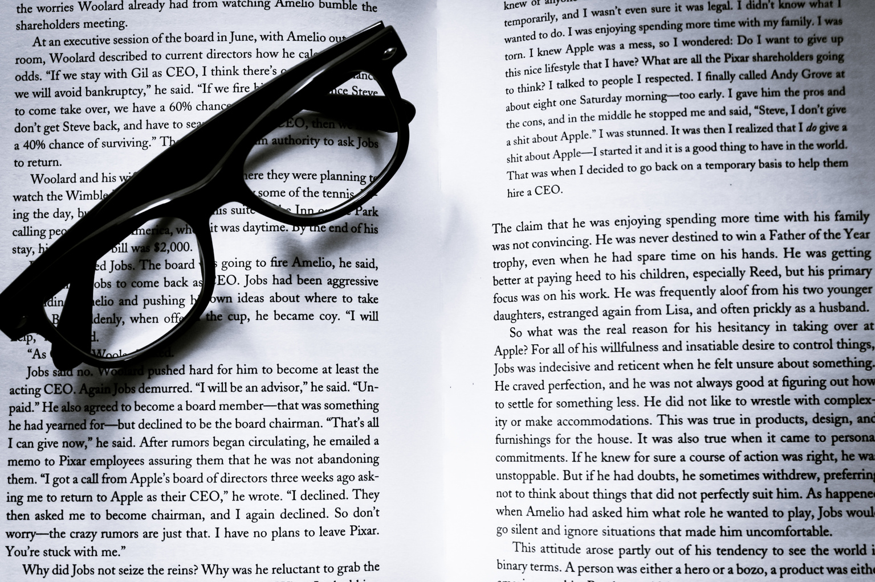

Project Name
Textus
Textus will be a web application where you can get extract-based summaries of drastically lengthy text. Text can be extracted from images or directly typed. Textus also allow conversion summary to different languages.

Slide 4
Motivation of the Project
Why this ?
There are various real world situation when we need quick summaries to lengthy articles like newspaper article, and other reports. Now what if the article that we are reading is in the hard copy or its language is different and we just wanted to get some insights without language as barrier.
The answer is TEXTUS.

Slide 5

Feasibility Study
Market:
10k searches related to summary generator[1].
Technology:
Extract based
word probability
tfidf
supervised ML
Abstractive based
Extractive Vs Abstractive[2]
Semantic representation,
inference and
language generation

Slide 6
Feasibility Study
Executive feasibility:
Input (jpeg, .txt)
Ocr for text extraction
Summarization using tfidf methodoly[3].

Slide 7
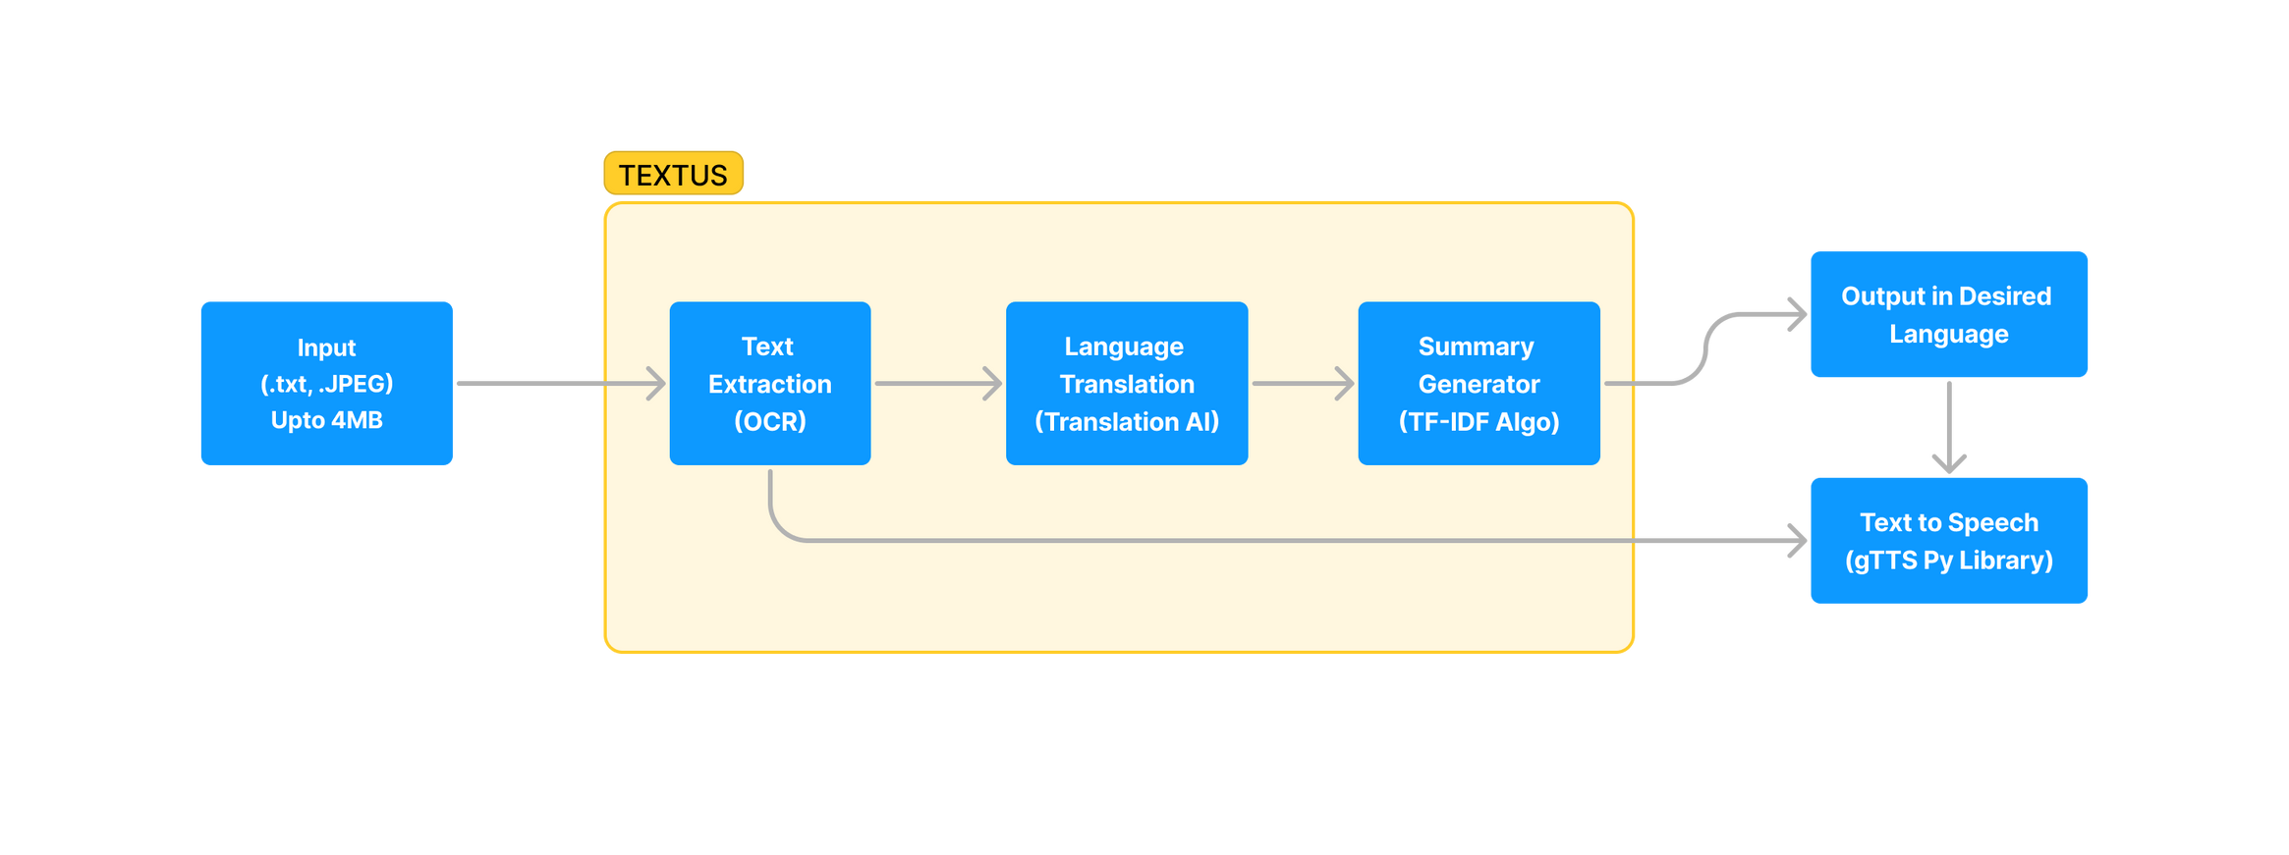
Work Flow
Figure A: Textus Architecture

Slide 8






How Textus will possible
Technology we will use
For interface development we will use React js, which we will integrate with restfull django server.
Azure OCR for text extraction from image.
Translation Ai for language conversion.
All development work will be done on Visual Studio code.

Slide 9


References
1. For market analysis: https://neilpatel.com/ubersuggest/
2. Research paper for techinques of sumarry generator: https://arxiv.org/pdf/1707.02268.pdf
3. Research paper for summary generator approach using tfidf: https://journal.binus.ac.id/index.php/comtech/article/view/3746/3037

Slide 10
Thank You
Change is the only Constant

